Slide 1



2019 Q1 SALES REPORT
SALES REPORT

Slide 2

INTRODUCTION
PURPOSE OF THE REPORT
This report includes an analysis of customer behavior, sales performance, and product trends at Infinity Supermarket's branches in Yangon, Naypyitaw, and Mandalay.
01

Slide 3
AGENDA
Customer Performance
Product Performance
Sales Performance
02

Slide 4
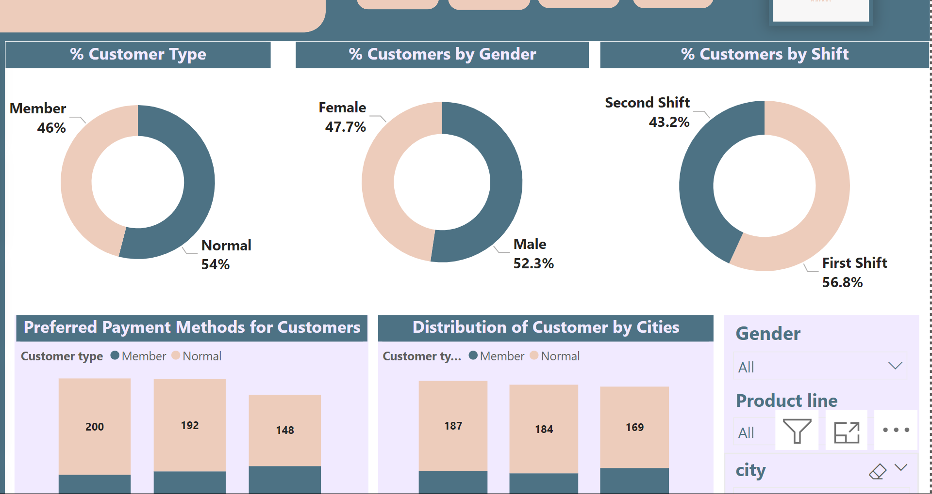
CUSTOMER OVERVIEW
The customer base is fairly balanced between genders. Additionally, the data shows that 46% of customers are members, while 54% are Noraml. These insights provide a snapshot of the customer demographics and membership distribution, which can inform targeted marketing and customer engagement strategies.
04
03

Slide 5
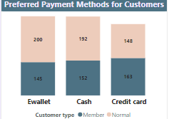
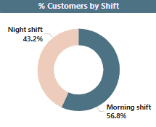
CUSTOMER OVERVIEW
CON
After analyzing the data, we found that the preferred payment method differs between customer types. "E-Wallet" is the most favored payment option among normal customers, while members show a strong preference for using credit cards
We found that customers prefer shopping in the morning.
04

Slide 6
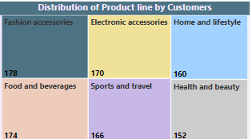
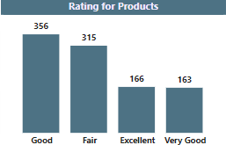
PRODUCT LINE
We also found that accessories were among the most popular products for customers, followed by food and beverages. This reflects the importance of these categories in attracting customers and increasing sales.
It turns out that most of our products received a Good rating from customers, which indicates general satisfaction but also shows there's room for improvement.
05

Slide 7
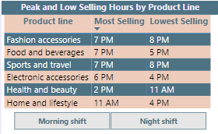
PRODUCT LINE
Peak Selling Hours:
The 7 PM hour is the peak selling time for Fashion Accessories, Food and Beverages, and Sports and Travel. This indicates a strong evening shopping trend for these categories.
Lowest Selling Hours:
The lowest selling hours vary, with significant differences across product lines. For instance, Food and Beverages see a drop in sales at 5 PM, while Health and Beauty experience the lowest sales at 11 AM.
06

Slide 8
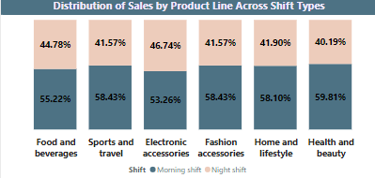
SALES
We also found that sales are higher during the morning shift compared to the night shift. The top three products driving these sales are Food and Beverages, Sports and Travel, and Electronic Accessories.
07

Slide 9
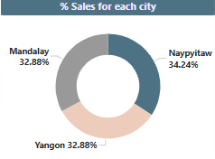
SALES
When we analyzed sales by city, we found that Naypyitaw is the highest-performing city in terms of sales.
07

Slide 10
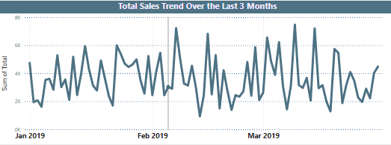
SALES
The highest number of transactions was made on 8th on January, 7th in February and 14th in March
08

Slide 11
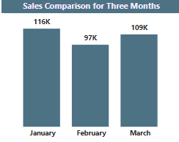
SALES
We also found The highest sales and number of transactions was made in moth January
11
09

Slide 12
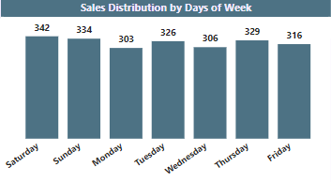
SALES
Finally The highest sales volume occurs on Saturdays.
11
09

Slide 13

WARDIERE.INC
RECOMMENDATION
01
02
03
04
Boost Home and Lifestyle sales with promotions and bundle deals, and improve product quality for better customer satisfaction.
Place the top-selling product line at the end to ensure customers pass through lower-selling lines on their way in and out.
We recommend launching an online market to expand our customer base and increase our reach.
Offer unique perks for members, such as special discounts, early access to sales, and member-only events.
10

Slide 14


CONCLUSION
In conclusion, the report gives clear insights into Infinity Supermarket’s performance. Naypyitaw is the top-selling branch, and customers prefer to shop in the morning and evening. Popular products include accessories, food, and beverages. By focusing on these trends, Infinity Supermarket can improve customer satisfaction and increase sales across all branches.
09
11

Slide 15



Thank You

